Slide 1
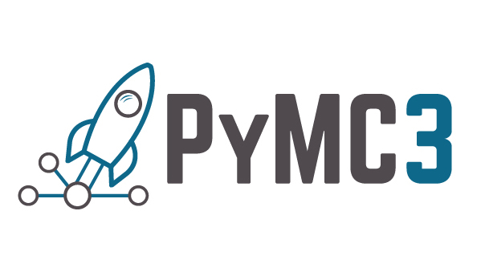

Slide 2
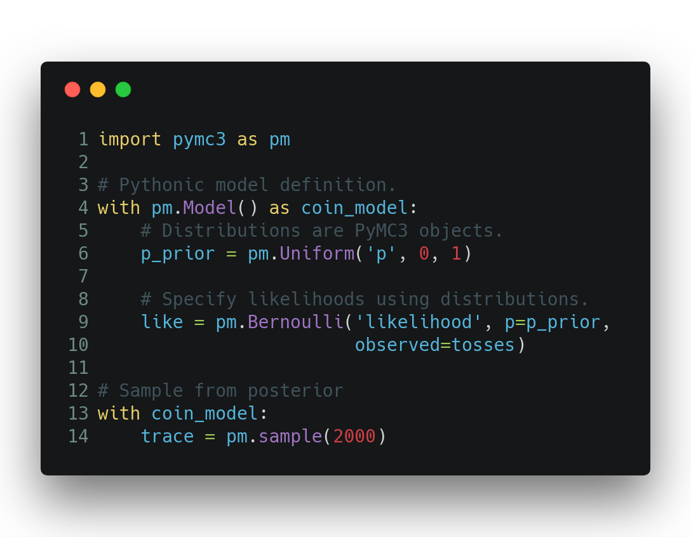
PyMC3: Probabilistic Programming in Python
Library of probability distributions.
Powerful algorithms for sampling and inference.
A welcoming & intuitive API for model specification.
Used in diverse fields: astrophysics, biomed, finance, marketing, etc...
Notes:
Introduce PyMC3

Slide 3
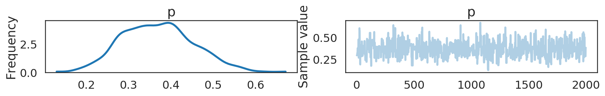
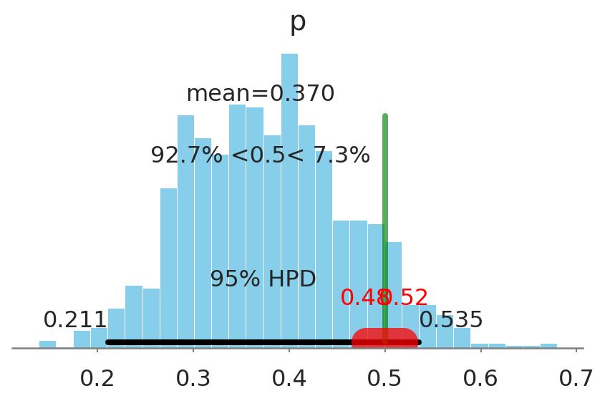
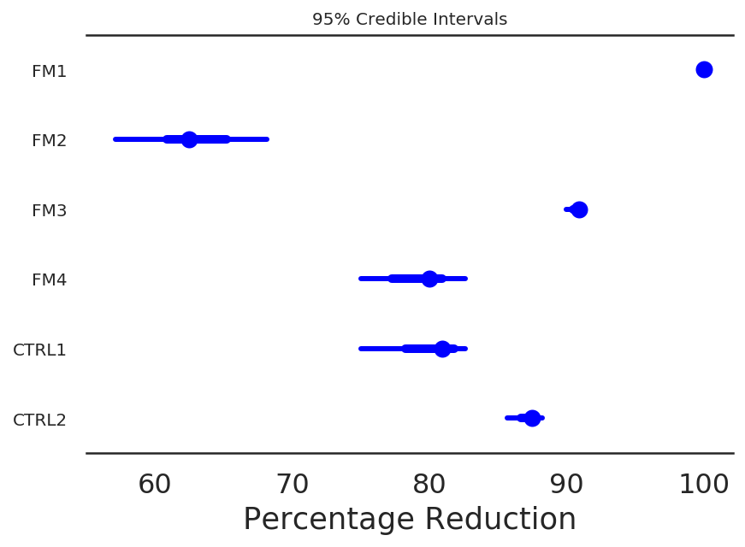
PyMC3 provides visual tools for Bayesian inference
Notes:
More features that PyMC3 has

Slide 4
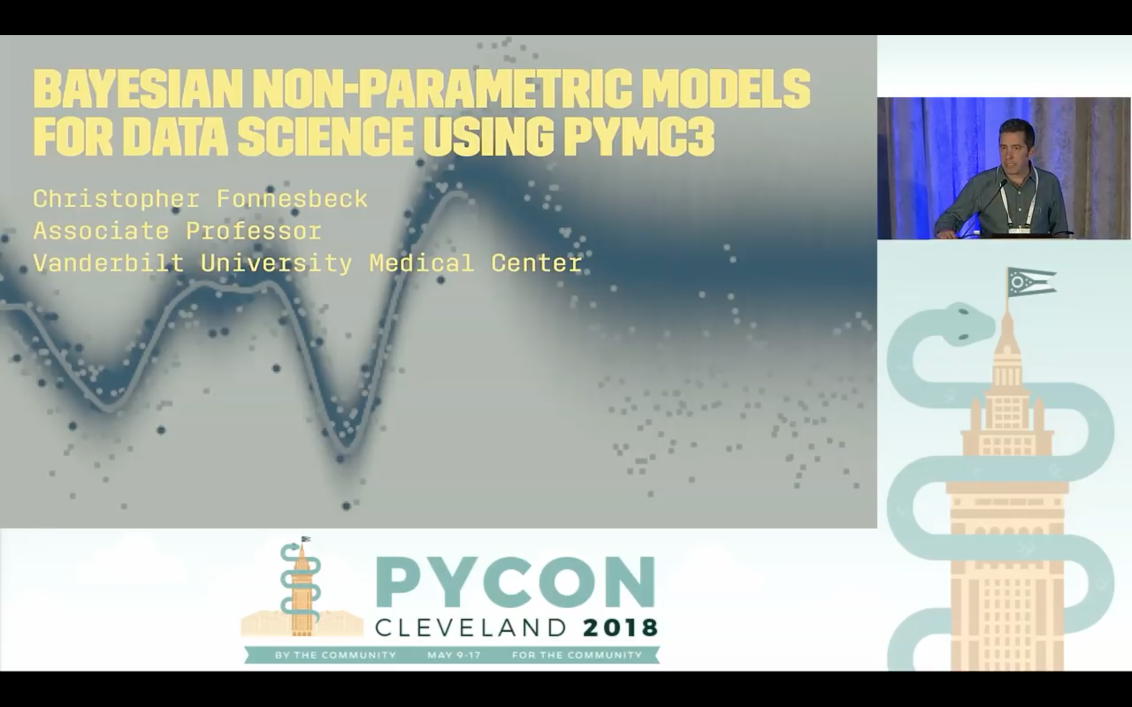
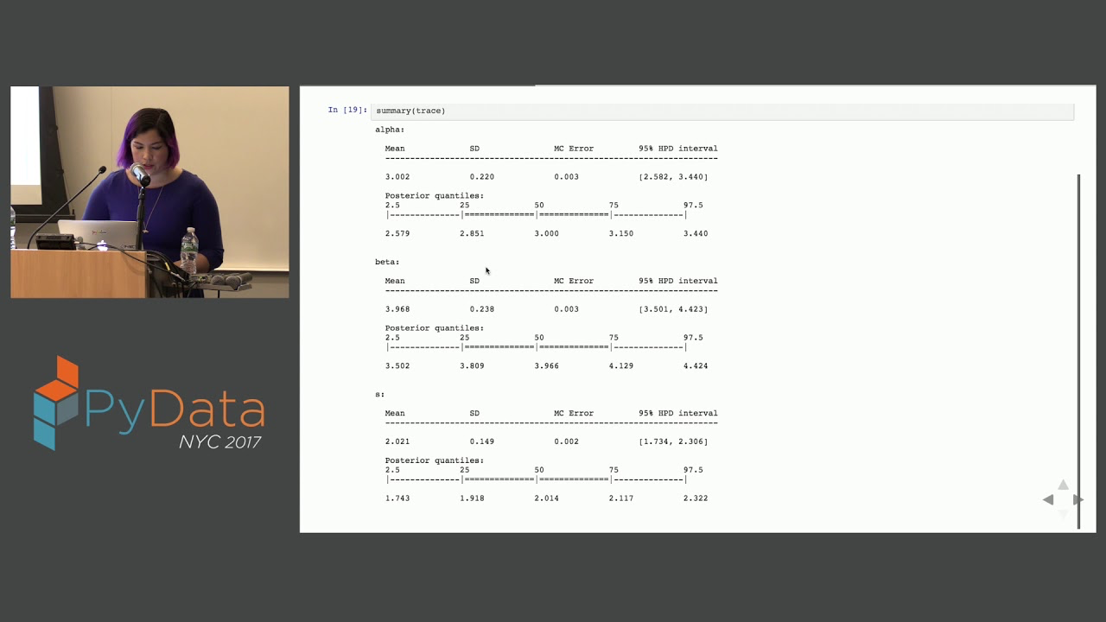
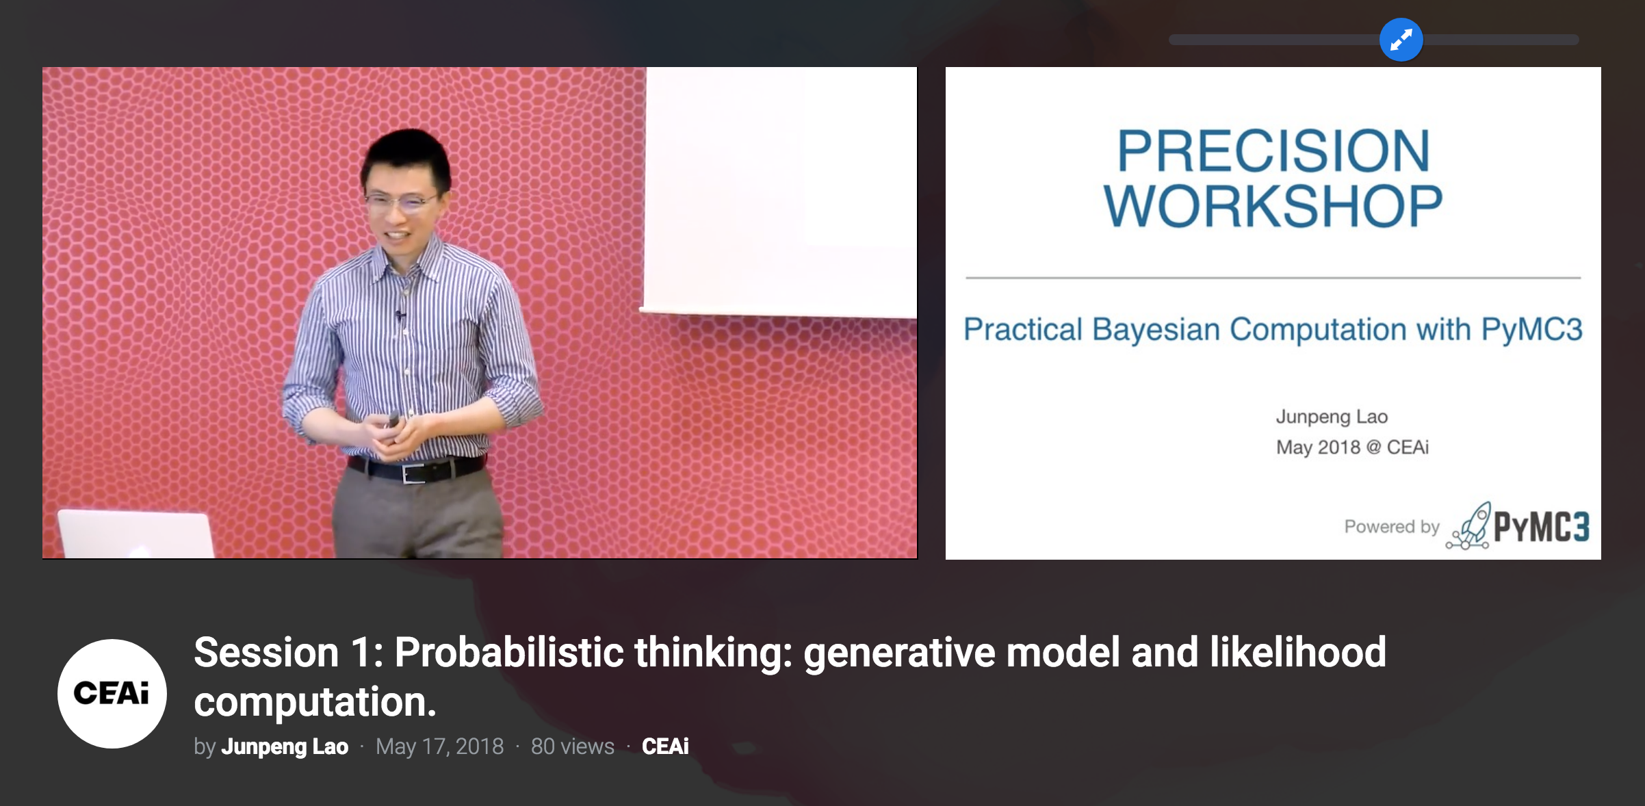
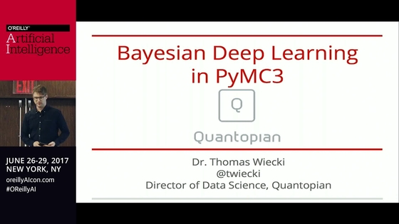
Wealth of learning resources
Notes:
Introduce the fact that there are learning resources available online: publicly available talks, tutorials, blog posts, etc.

Slide 5

PyMC3’s future and
Q: Since Theano is not being developed further, what happens to PyMC3?
A: PyMC devs will take over Theano maintenance for PyMC3 purposes, until PyMC4 is released. Explicitly not accepting new features into Theano.
Q: What is PyMC4 going to look like?
A: Still in development, Tensorflow is selected for the new backend, focus on retaining intuitive API, experiments with an alternative “functional” API.
Notes:
Address biggest concern regarding PyMC3 and theano.

Slide 6



Come talk with us!
Colin Carroll Peader Coyle Bill Engels Christopher Fonnesbeck Maxim Kochurov Junpeng Lao Eric Ma Osvaldo Martin Kyle Meyer Michael Osthege Austin Rochford Adrian Seyboldt Hannes Vasyura-Bathke Thomas Wiecki Taku Yoshioka
pymc-devs/pymc3
discourse.pymc.io
docs.pymc.io

